Slide 1
AI-in-One: Storyboard

Slide 2
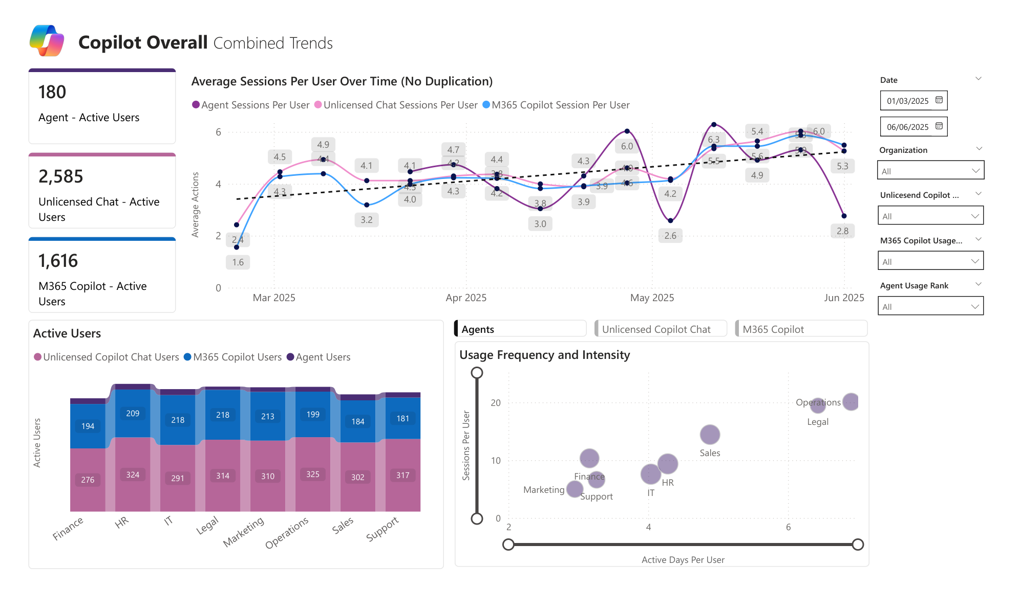
The Funnel Is Real: Chat → Copilot → Agents
Example visual
What it means
  Bottom-up pull is strongest in Chat; it’s the top-of-funnel signal for demand and use-case discovery.
  Engagement varies by function, revealing where near-term business value will materialize first.
  Different products map to different jobs: quick assist in Chat, deeper assist in Copilot, repeatable workflows in Agents.

Slide 3
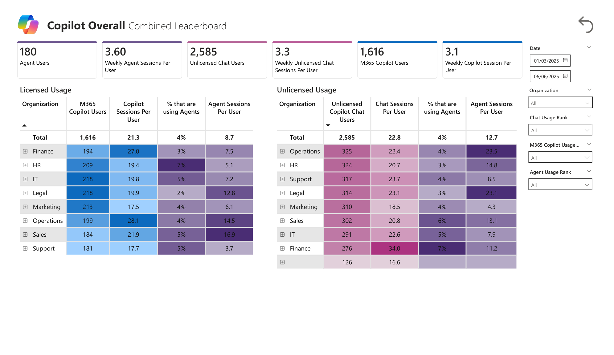
One View to Orchestrate: Licensed + Unlicensed + Agents
Example visual
What it means
  M365 Copilot licensed users show a higher usage of Agents across the board.
  On the unlicensed front, Operations/IT/Finance/Legal show the highest readiness for M365 Copilot. Their unlicensed prompts as well as agent activity mirror their licensed counterparts

Slide 4
Agents

Slide 5
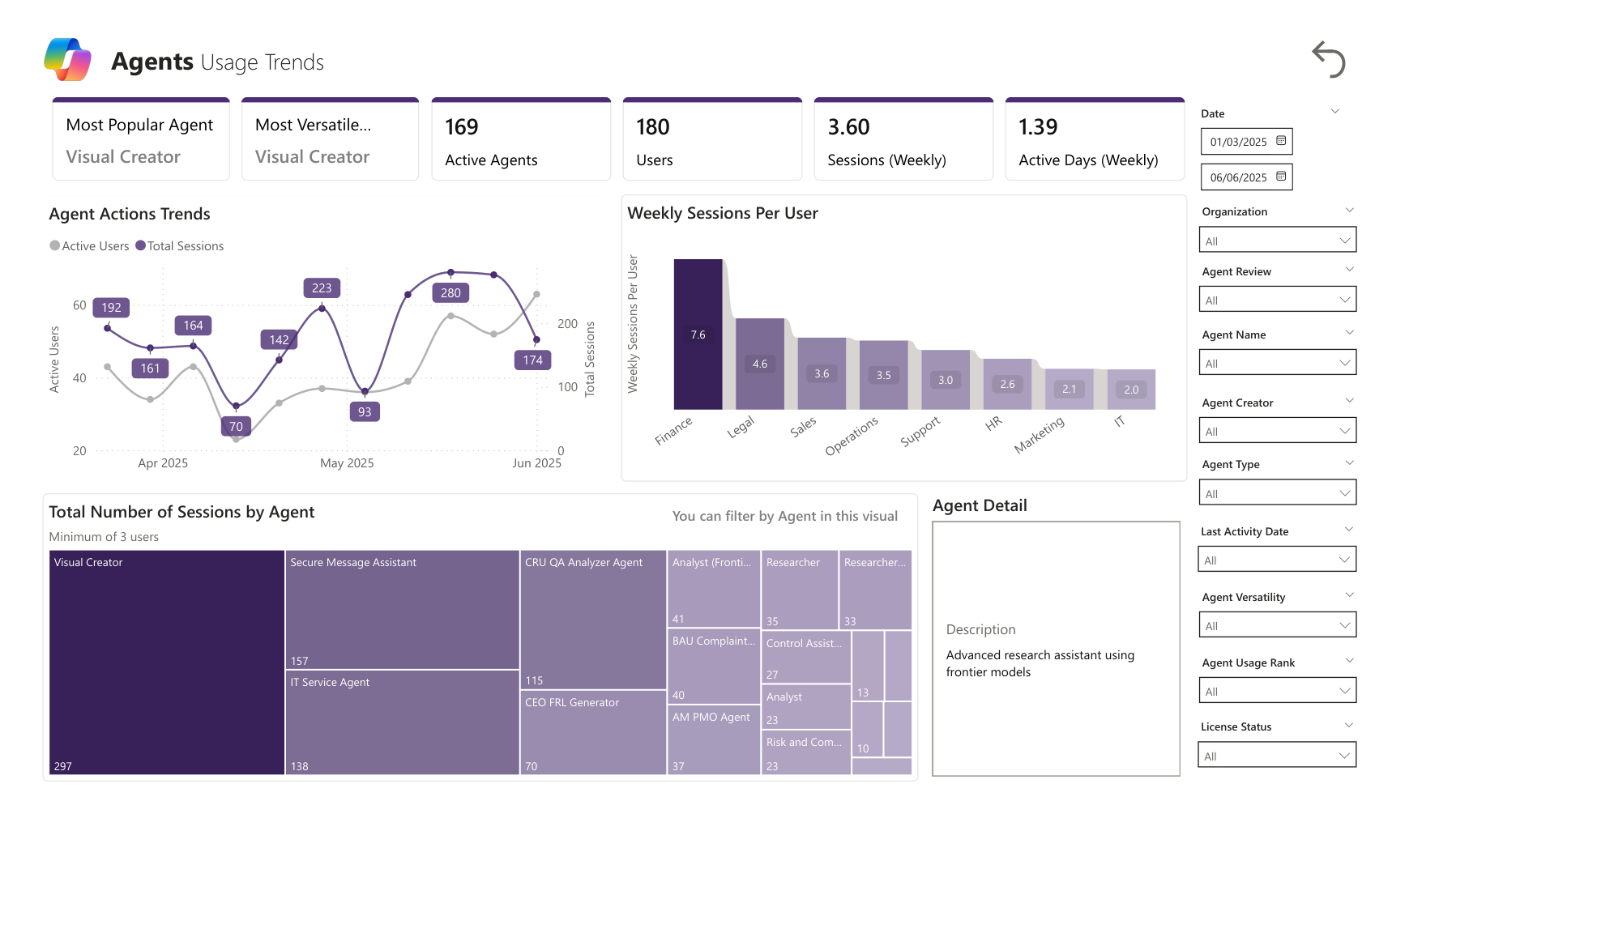
The Agent Pattern: Few Hits, Clear Workhorses
Example visual
What it means
  A small set of agents carry outsized usage
  Agent activity and agent users are both rising with ____ and ____ showing the highest traction.
  Weekly sessions per user: ____ across ____ users demonstrates strong engagement patterns.
Example visual

Slide 6
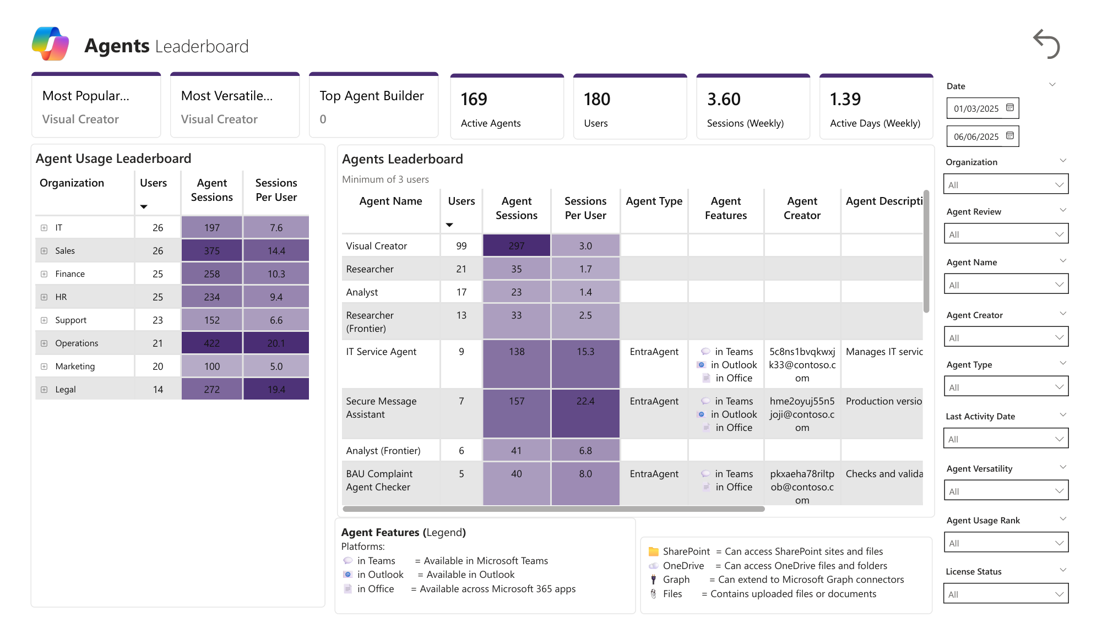
Where Agents Land: Function-Specific Intensity
Example visual
What it means
  ____, ____, _____ built by Microsoft have the highest users
  Custom agents _____, _____, _____have the highest intensity showing a clear fit with workflow
  Agents placed within ____, and ____, show highest usage intensity (sessions per user).

Slide 7
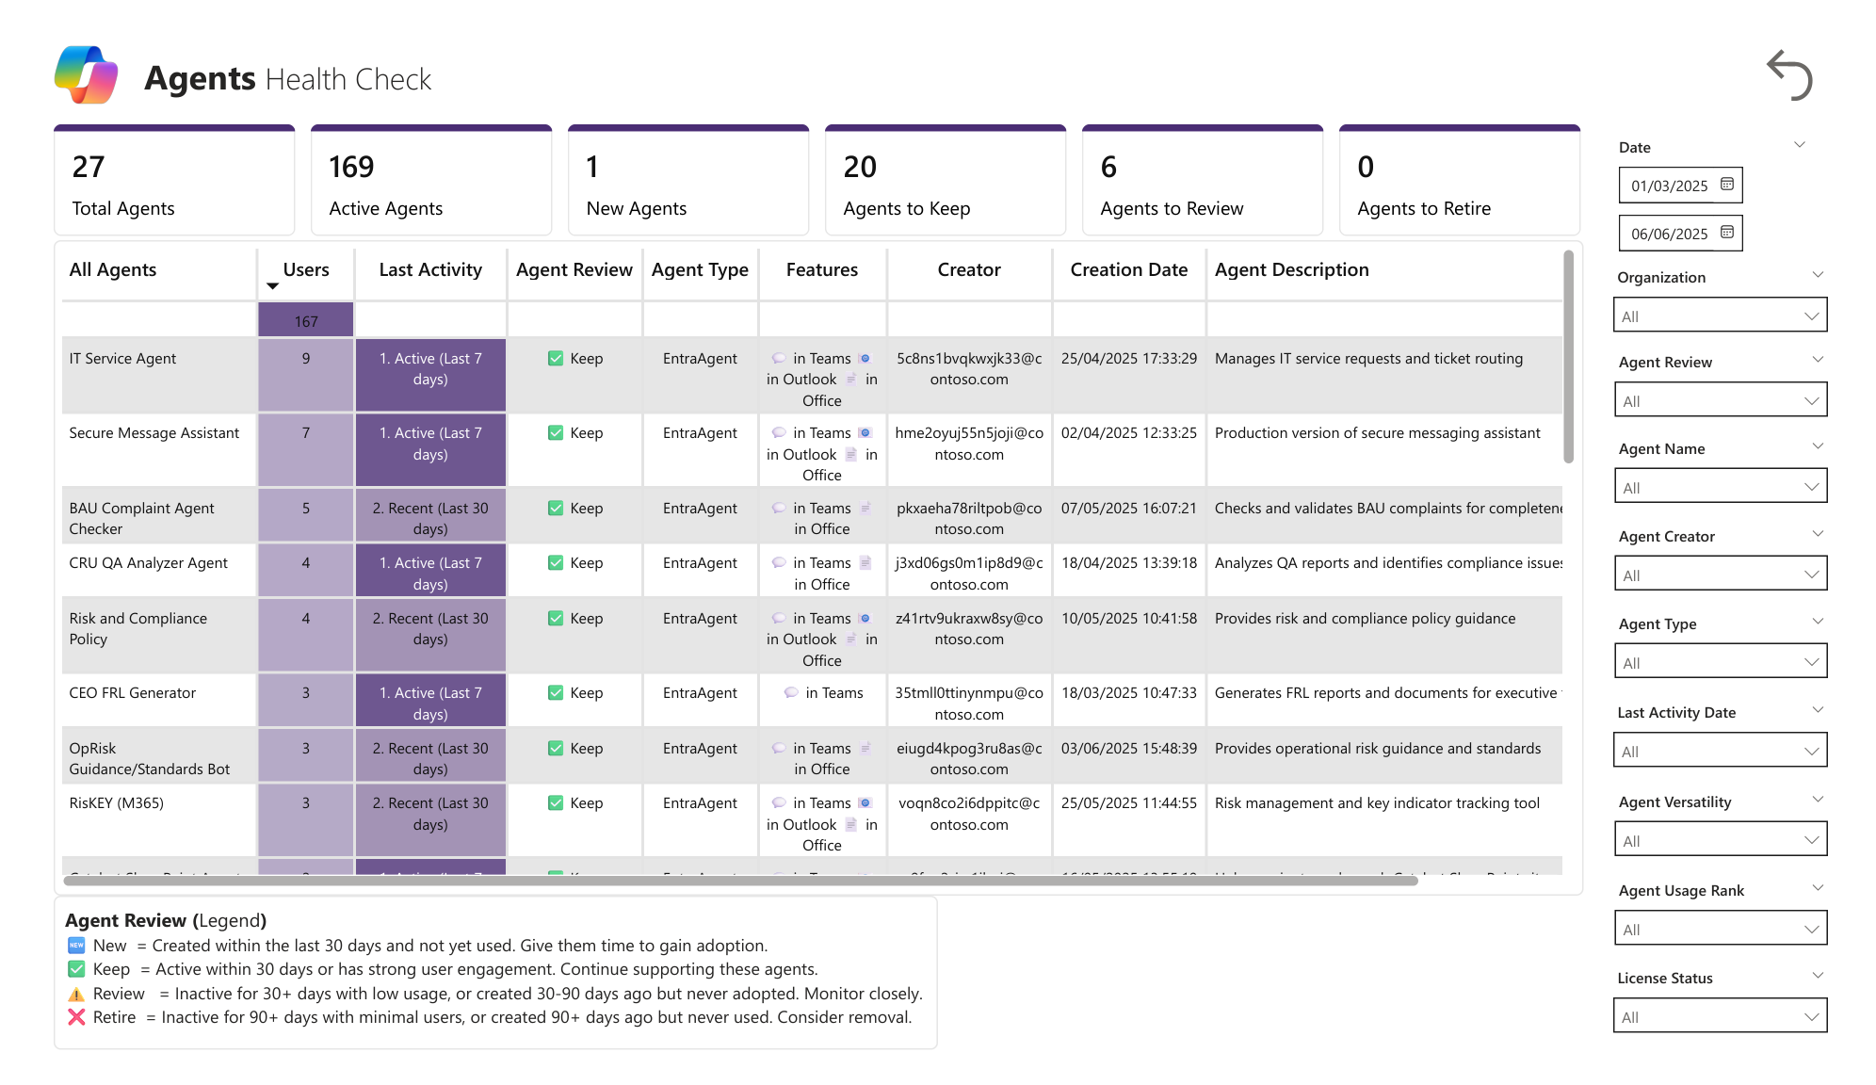
Portfolio Health: Govern to Grow
Example visual
What it means
  ___ agents are healthy; while ___ needs review.
  ___ agents have no activity and may need to be retired

Slide 8
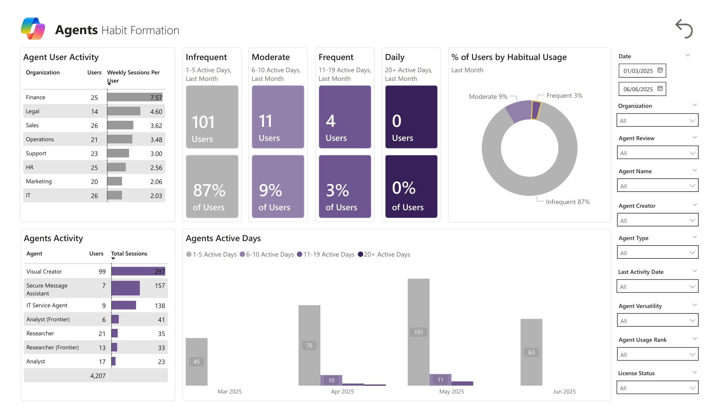
Agent Habits: Move Infrequent → Frequent
Example visual
What it means
  Most users have _____, activity; a small power-user cohort drives disproportionate value—classic early adoption.
  _____, -level differences suggest targeted coaching can meaningfully lift habits.

Slide 9
Copilot Chat

Slide 10
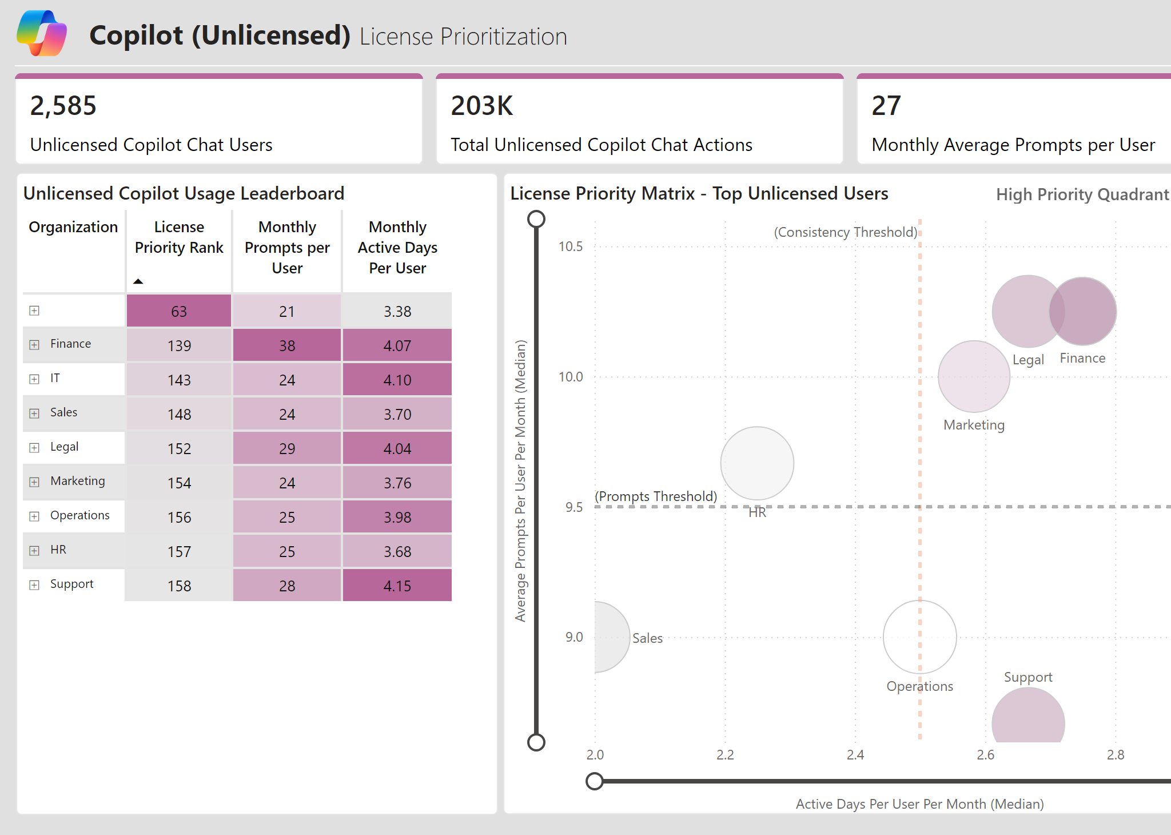
License Prioritization: Data-Led Conversion Engine
What it means
  High prompt volume + consistent active days identifies the highest-yield unlicensed users to convert.
  Marketing, Legal, and Finance lead the way both in frequence and intensity and are priority cohorts for licensing
  Sequencing licensing by function based on this grid creates a repeatable conversion motion.

Slide 11
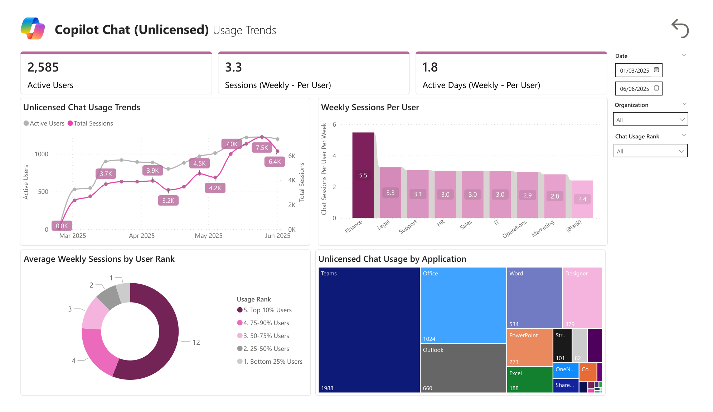
Where Chat Happens: Teams, Office, Documents & Meetings
Example visual
What it means
  Teams and Office dominate unlicensed chat usage entry points, centered on documents and meeting workflows.
  Word, pptx, and excel usage in chat further signal a need for enterprise solution
  Finance shows a clear lead in usage of Chat

Slide 12
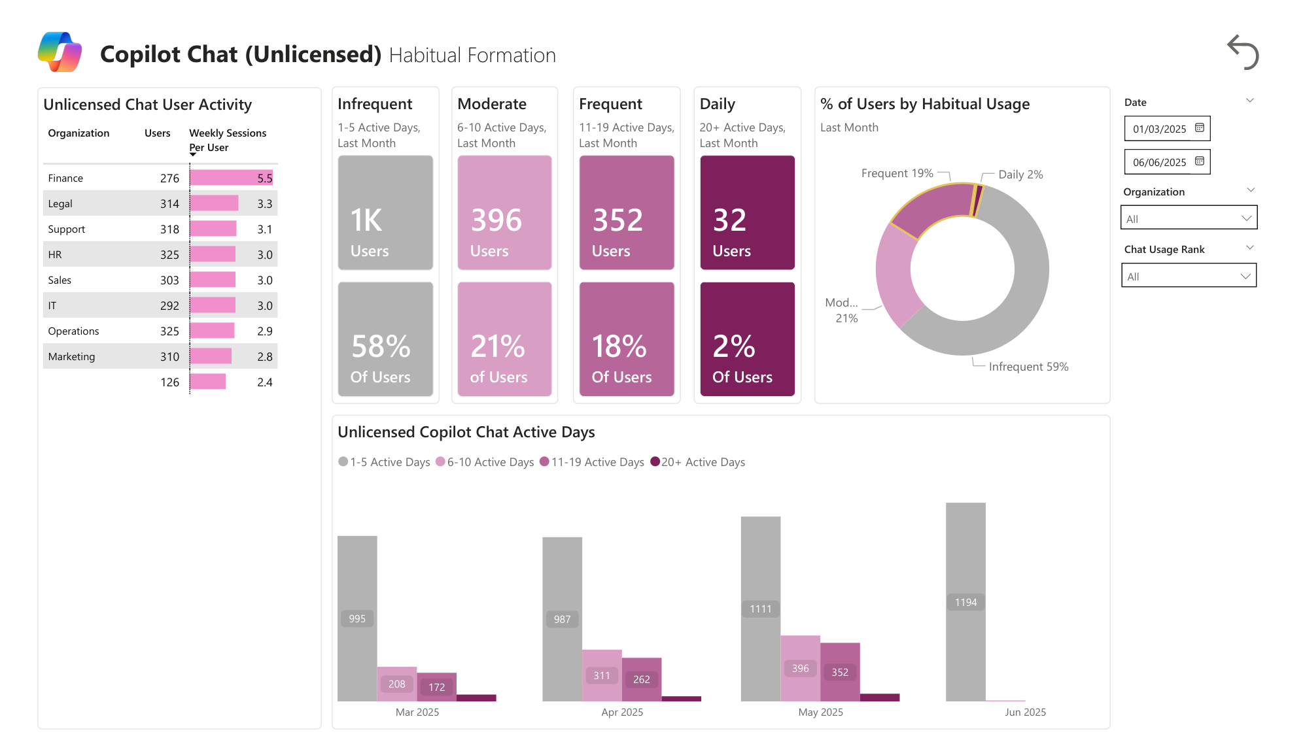
Chat Habit Formation: Many Are Close to Frequent
Example visual
What it means
  20% of unlicensed users are high frequency users of Chat and are demonstrating clear readiness
  21% are at the cusp of building habits and will soon be ready for licensing
  Light coaching can shift many users one tier up in active days.

Slide 13
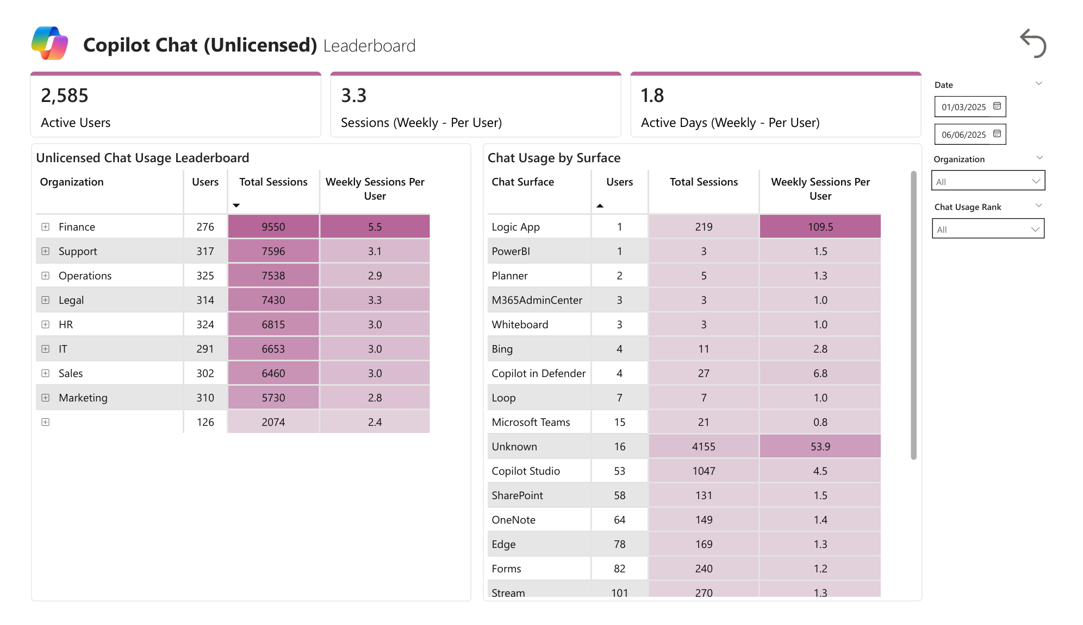
Long Tail of Apps, Short List of Winners
Example visual
What it means
  We are seeing an average of 27 actions/month among unlicensed users compared to 48 actions in licensed user population
  Teams and Outlook are the surfaces with highest users.

Slide 14
M365 Copilot

Slide 15
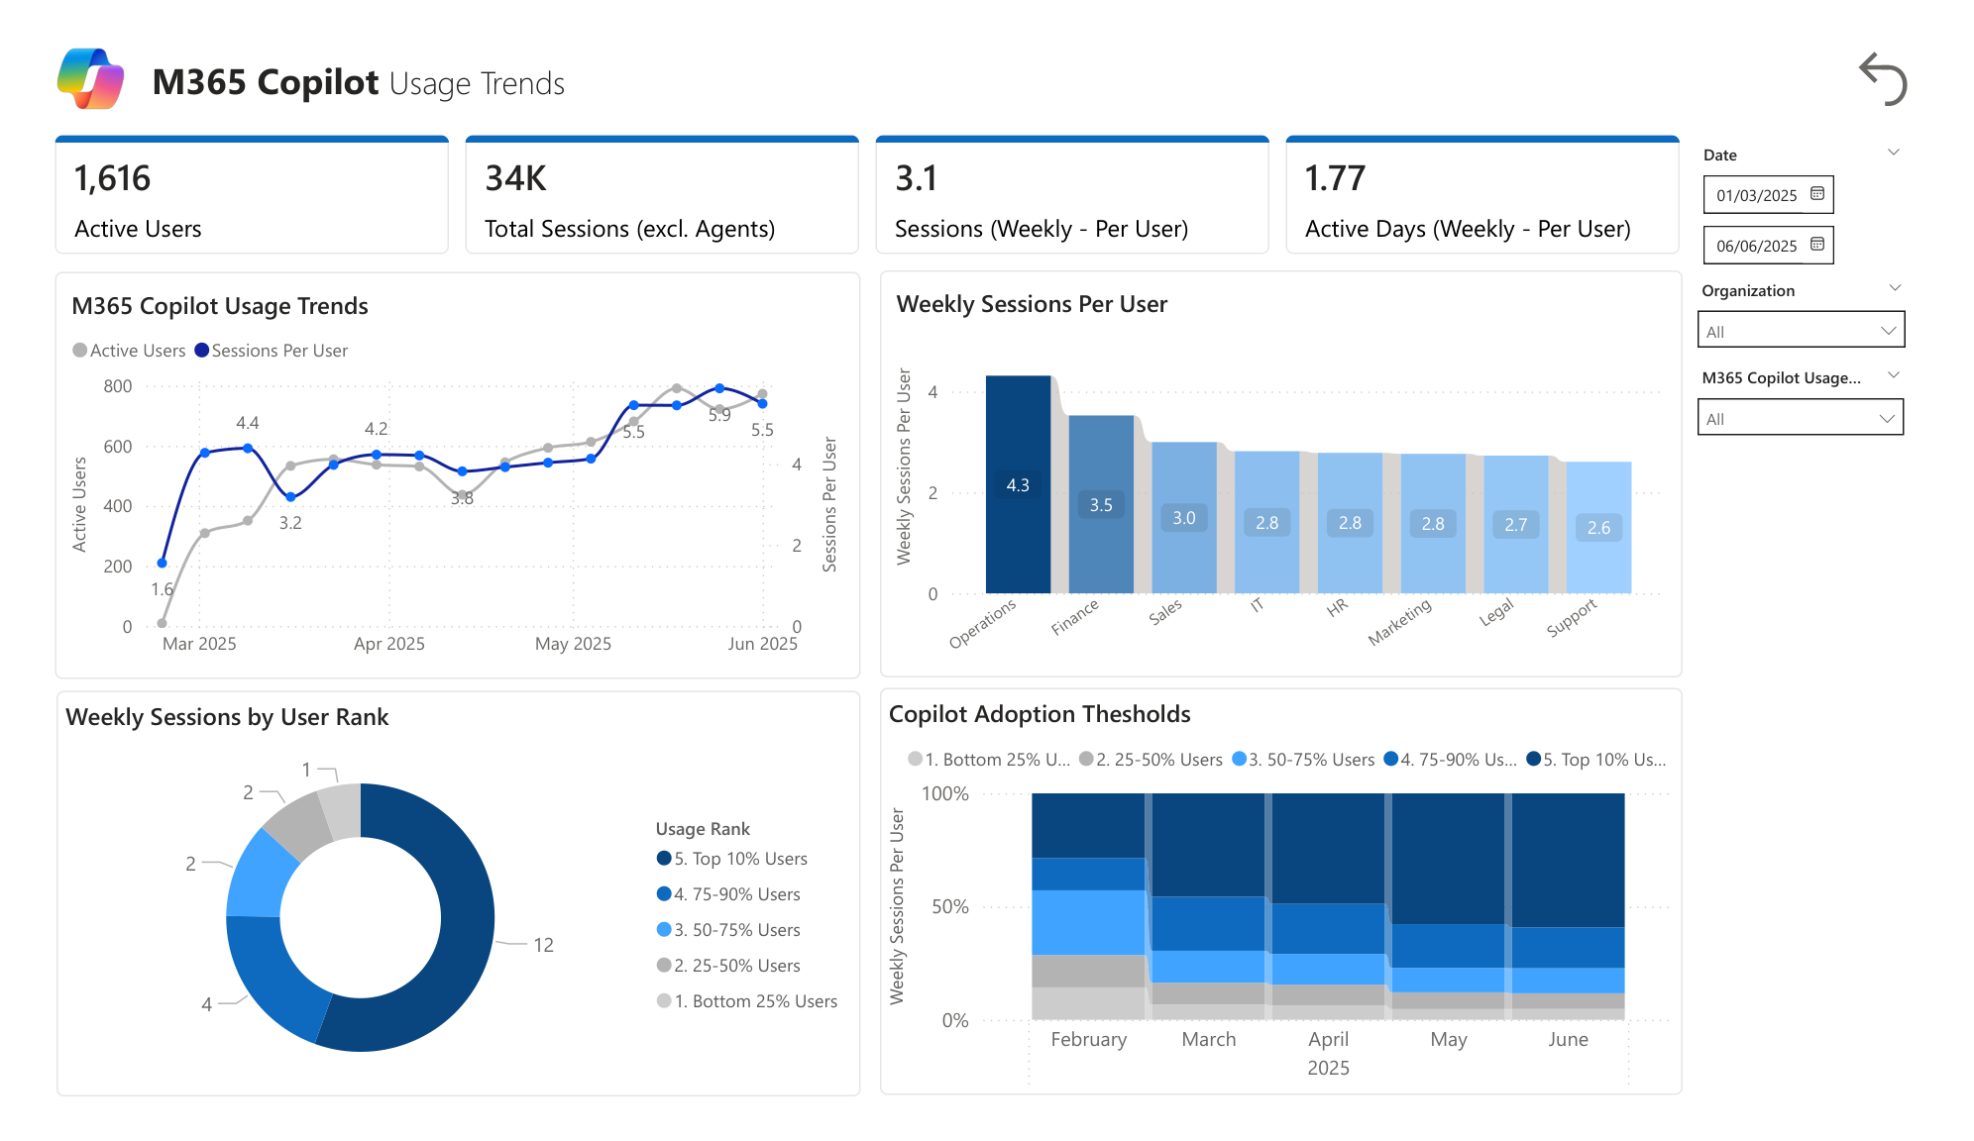
M365 Copilot: Depth Per User Validates the License
Example visual
What it means
  Per-user intensity is higher once users are licensed—value deepens beyond casual chat.
  Top user bands generate outsized weekly actions—your champions and pattern sources.

Slide 16
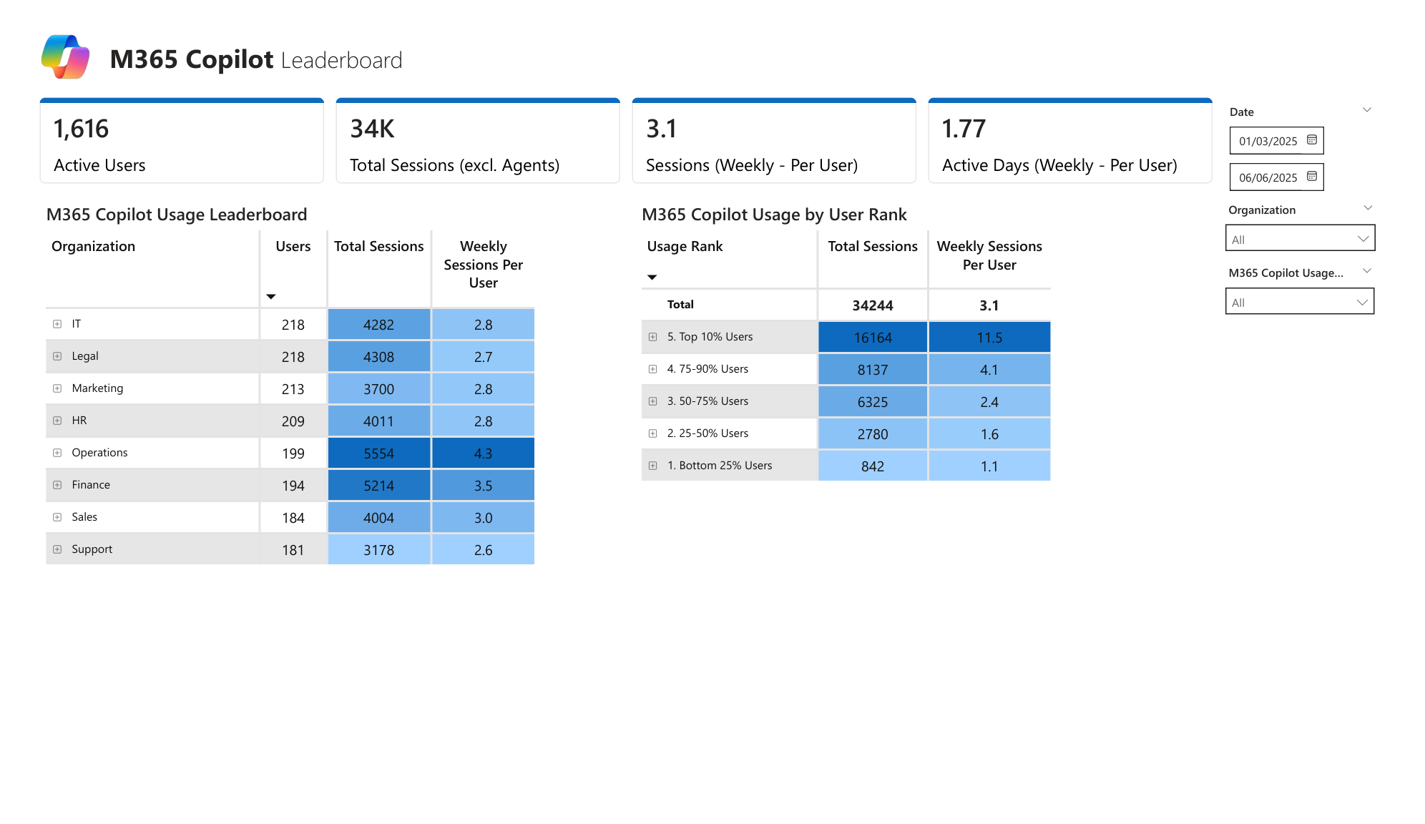
Uneven Distribution: The Vital Few Drive Most Copilot Actions
Example visual
What it means
  Top quartiles—especially the top decile—account for a large share of activity (power-law adoption).
  Function leaderboards help target communications and success stories precisely.

Slide 17
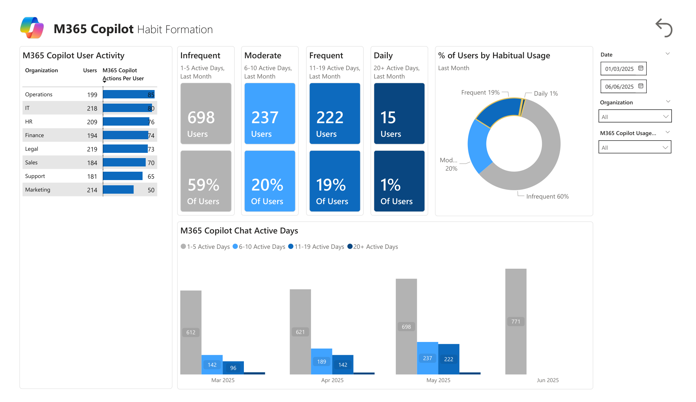
Copilot Habits: Good Start, Needs Daily Routines
Example visual
What it means
  Majority of the licensed users are high frequency users already
  Ops/IT/Finance/Legal have the highest proportion of frequent and daily active users

